Slide 1
High Frequency Response

Slide 2
Internal Capacitive Effects and the High-Frequency Model of the BJT

Slide 3
Introduction –Internal Capacitances
In our study of the physical operation of the BJT in previous Section , we assumed transistor action to be instantaneous, and as a result the transistor models we developed do not include any elements (i.e., capacitors or inductors) that would cause time or frequency dependence. Actual transistors, however, exhibit charge-storage phenomena that limit the speed and frequency of their operation

Slide 4
HIGH FREQUENCY RESPOSE
There are two parts to this analysis
Which Capacitances will come into play at high frequency
What will be the effect of these Capacitances

Slide 5
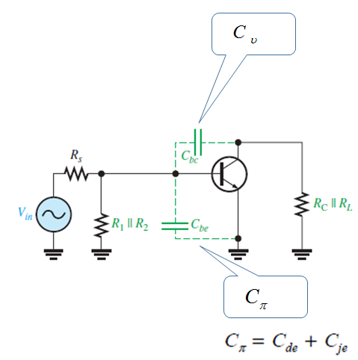
Types of internal Capacitances

Slide 6
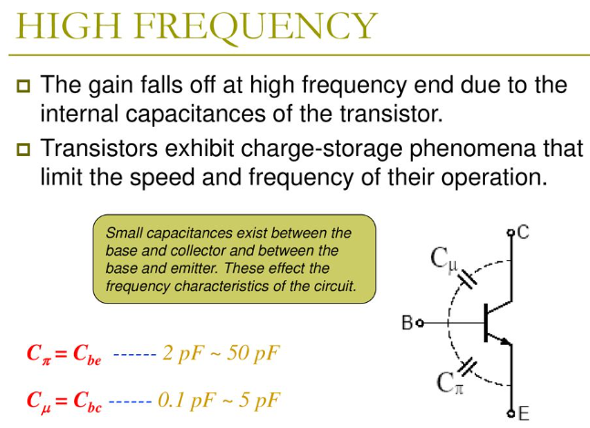

Slide 7
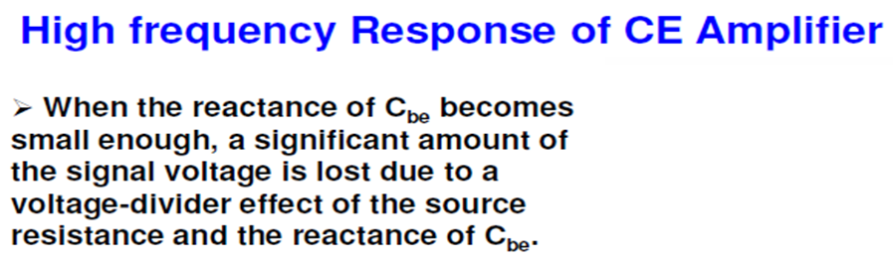
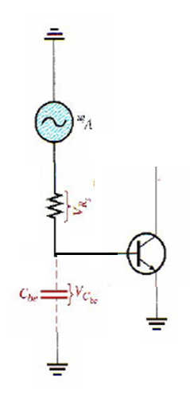
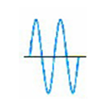
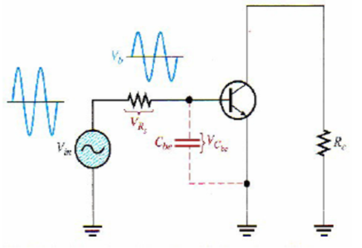
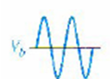

Slide 8
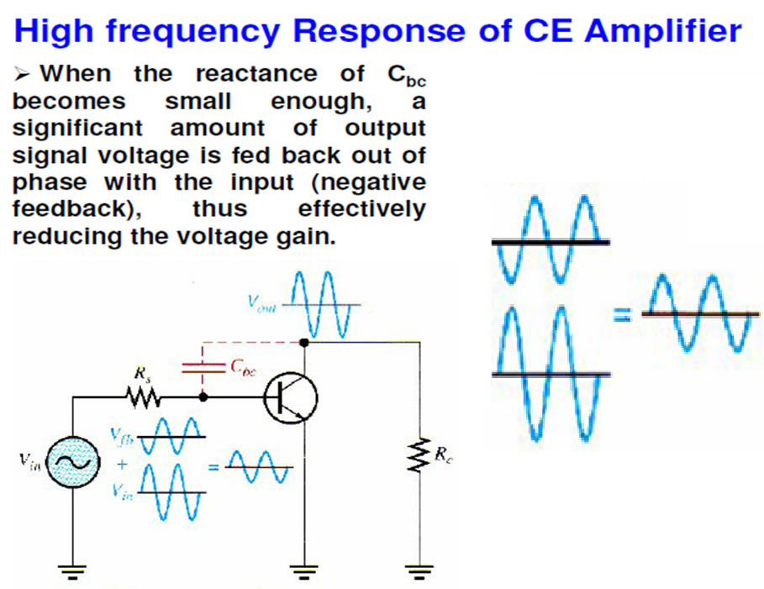
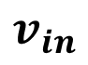

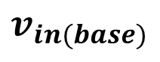
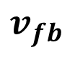
$$v_{fb}$$
$$v_{in(base)}$$
$$v_{in}$$
$$Note v_{in} and v_{fb} are {180}^{o} out of phase$$

Slide 9
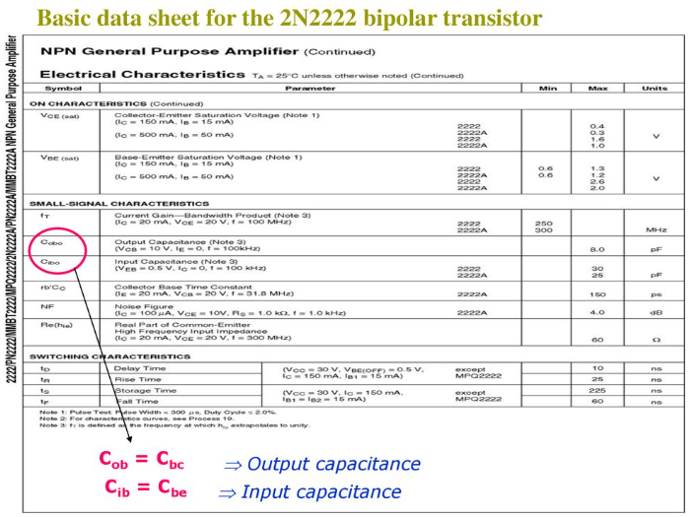
The value of these internal capacitances are given by the manufacturer

Slide 10
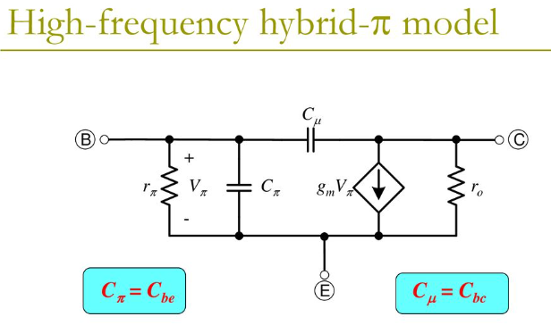
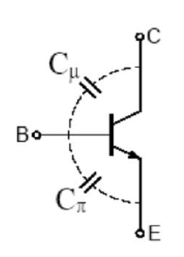

Slide 11
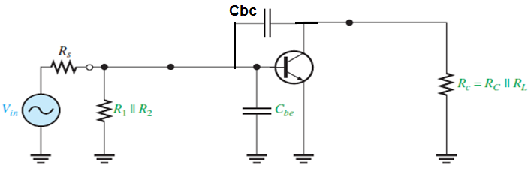
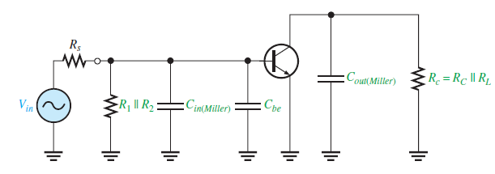
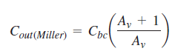
High-Frequency Analysis By applying Miller’s theorem
Looking in from the signal source, the capacitance Cbc appears in the Miller input capacitance from base to ground
Looking in at the collector, Cbc appears in the Miller output capacitance from collector to ground. the Miller output capacitance appears in parallel with Rc.

Slide 12
These two Miller capacitances create a high-frequency input RC circuit and a high frequency output RC circuit. These two circuits differ from the low-frequency input and output circuits, which act as high-pass filters, because the capacitances go to ground and therefore act as low-pass filters

Slide 13
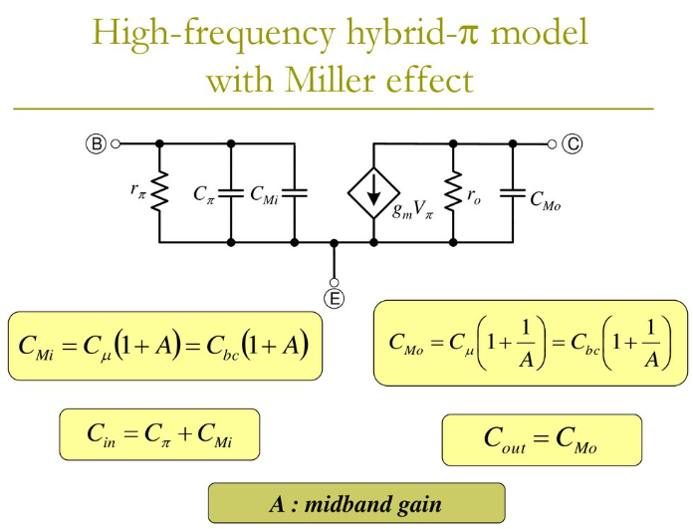

Slide 14
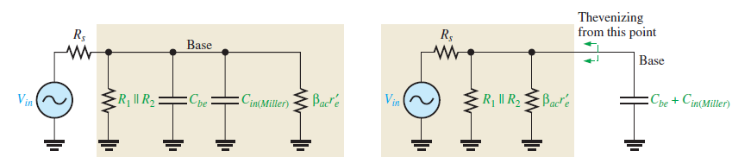
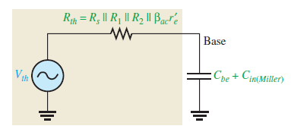
The Input RC Circuit
More Detailed analysis
As the frequency increases, the capacitive reactance becomes smaller. This causes the signal voltage at the base to decrease, so the amplifier’s voltage gain decreases. The reason for this is that the capacitance and resistance act as a voltage divider and, as the frequency increases, more voltage is dropped across the resistance and less across the capacitance. At the critical frequency, the gain is 3 dB less than its midrange value

Slide 15
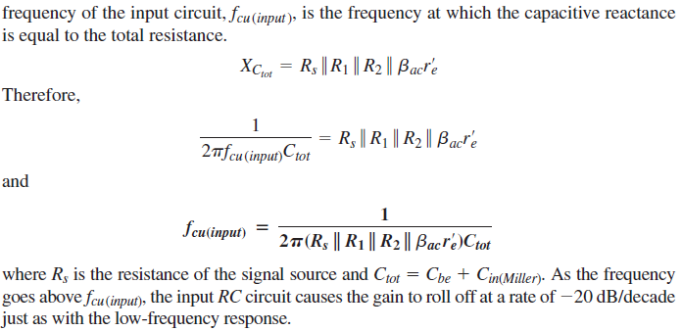

Slide 16
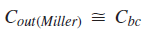
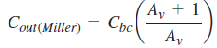
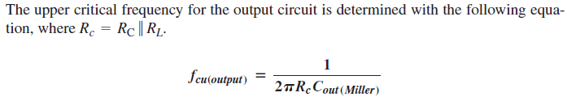
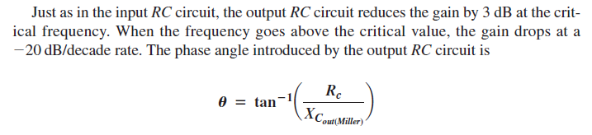
The Output RC Circuit
The equivalent output RC circuit consists of a resistance equal to the parallel combination of RC and RL in series with a capacitance that is determined by the following Miller formula:
OR

Slide 17
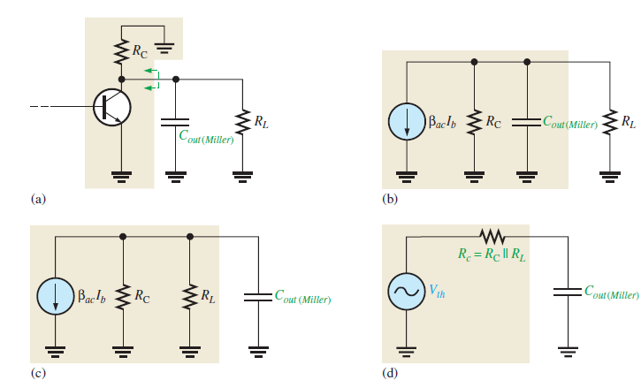

Slide 18
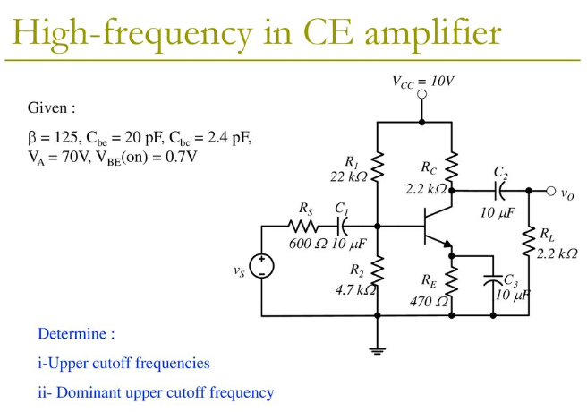

Slide 19
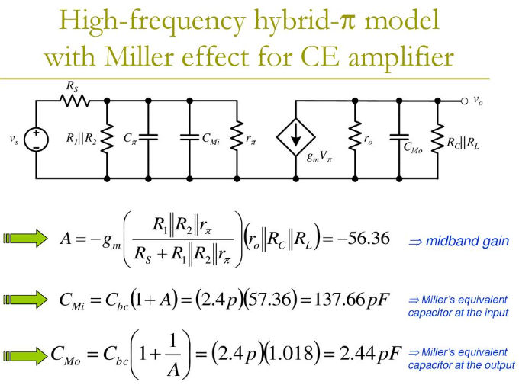

Slide 20
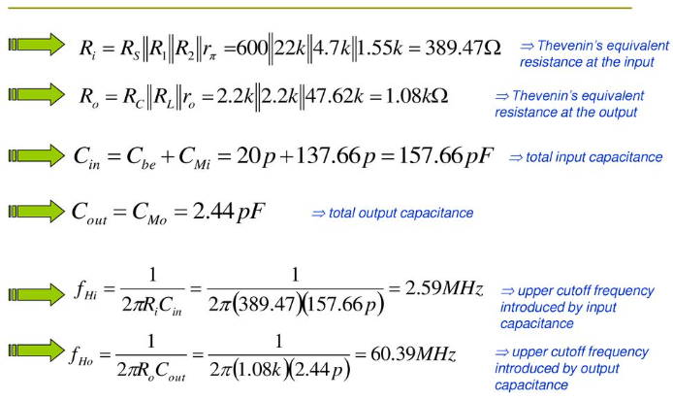

Slide 21
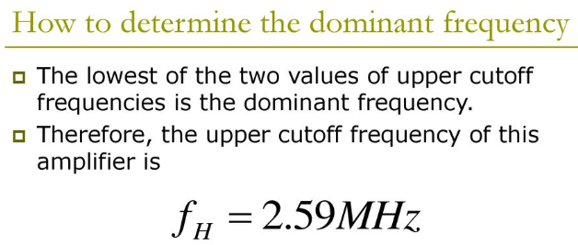

Slide 22
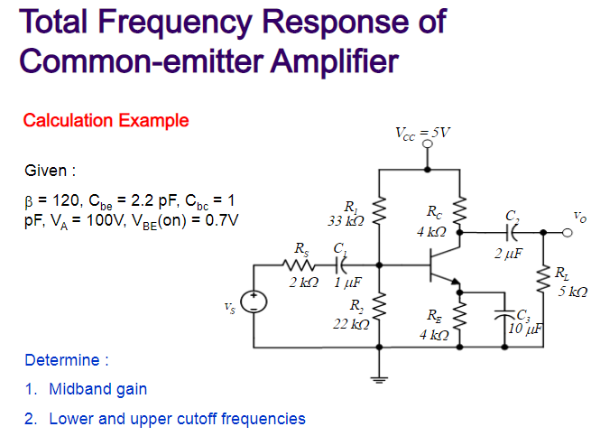

Slide 23
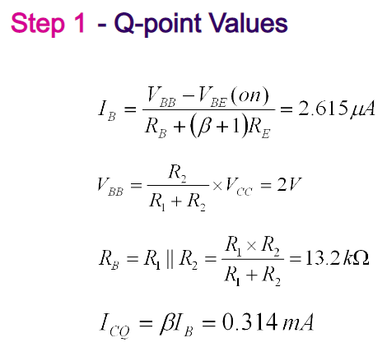
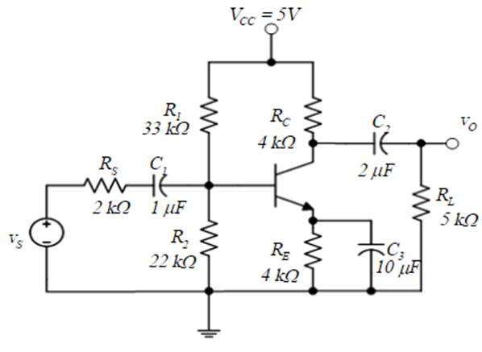

Slide 24
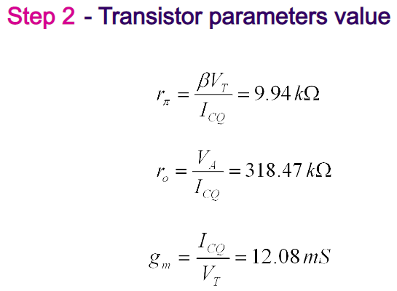

Slide 25
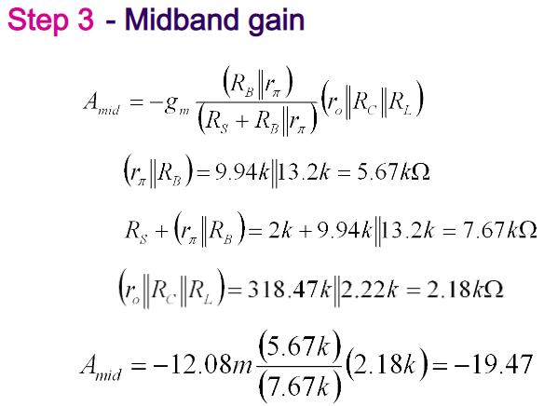

Slide 26
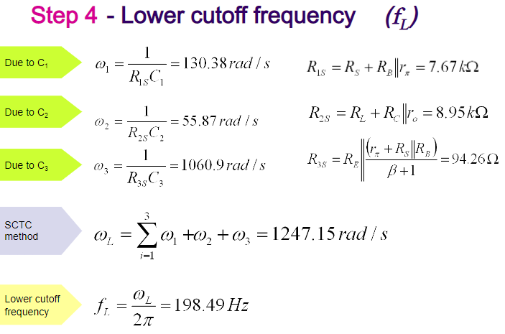

Slide 27
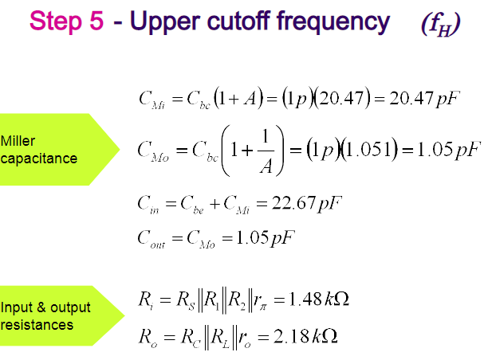

Slide 28
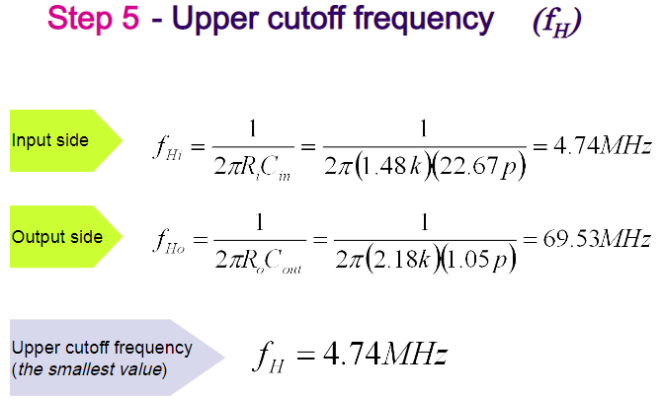

Slide 29
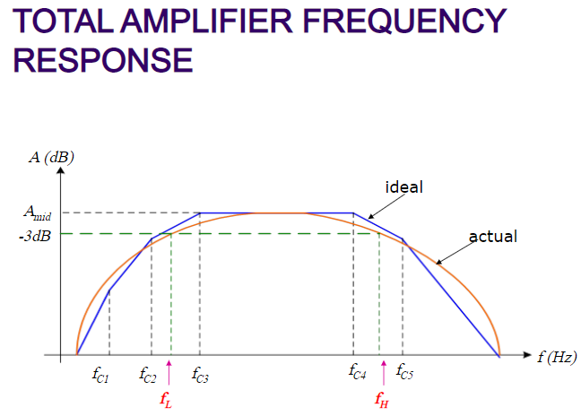
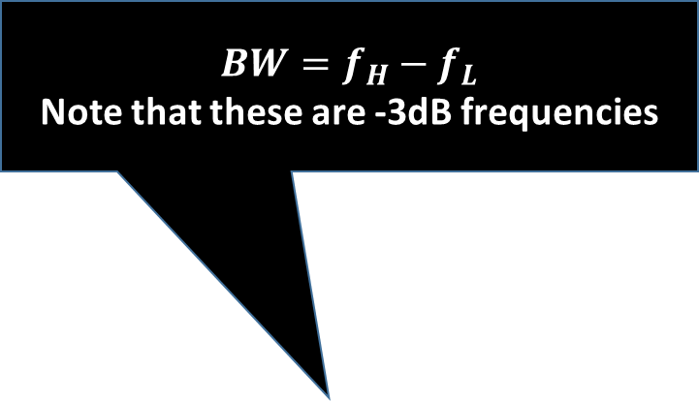
$$BW=f_{H}−f_{L}$$
Note that these are -3dB frequencies

Slide 30
BJT-Frequency Response
All Capacitors considered

Slide 31
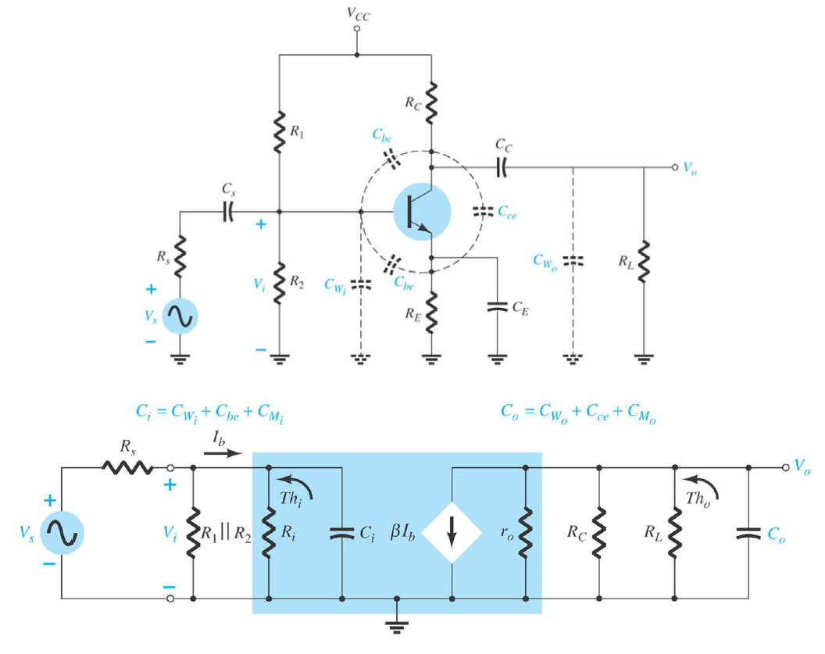
The total capacitances ; both external and internal for a BJT common emitter amplifier

Slide 32
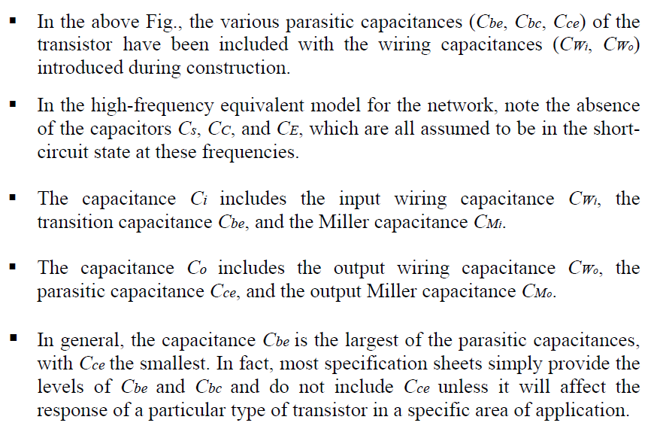

Slide 33
High Frequency Response of MOS Amplifier

Slide 34
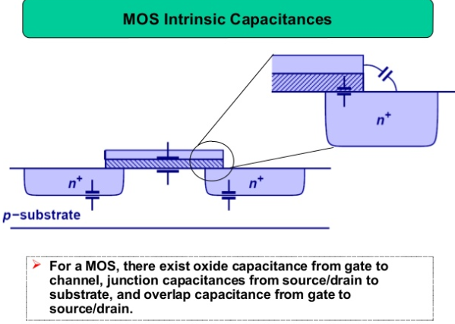

Slide 35
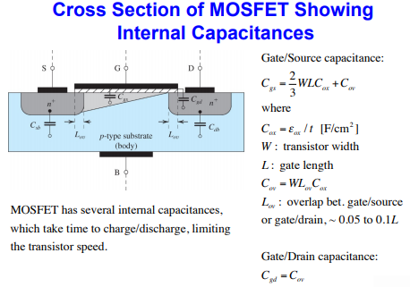

Slide 36
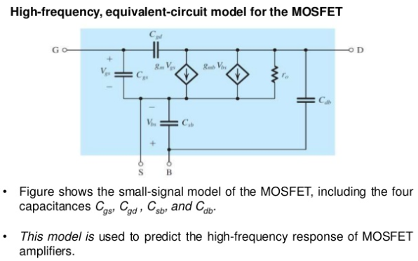

Slide 37
MOS Small signal Model
Simplified Model

Slide 38
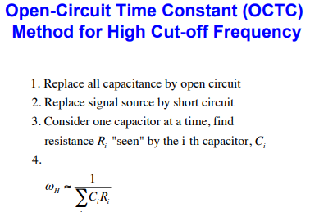

Slide 39
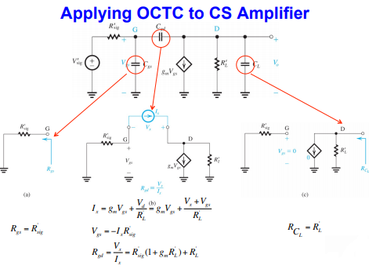

Slide 40
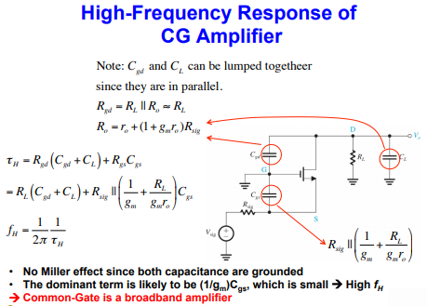

Slide 41
MOS High Frequency Response : Detailed analysis

Slide 42
Its an inverting amp. And gain will be with negative sign so –(-A)= A

Slide 45
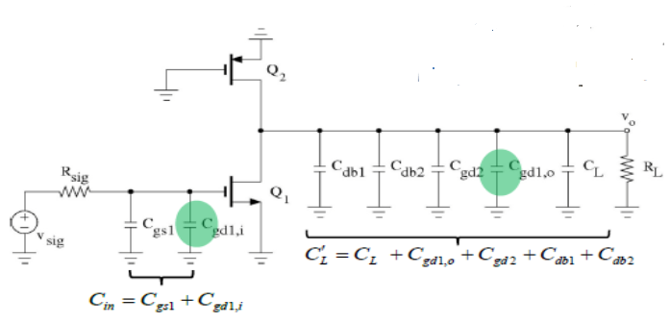

Slide 48
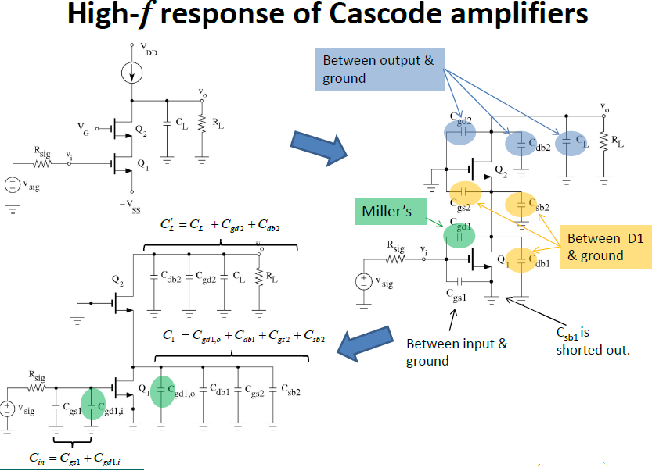

Slide 50
Differential Amplifier

Slide 51


Slide 53


Slide 54


Slide 55


Slide 56
High-Frequency Response of Differential Amplifiers
Analysis of the Resistively Loaded MOS Amplifier
(a) A resistively loaded MOS differential pair; the transistor supplying the bias current is explicitly shown. It is assumed that the total impedance between node S and ground, ZSS, consists of a resistance RSS in parallel with a capacitance CSS.
(b) Differential half-circuit.

Slide 57

The common-mode half-circuit is shown in Fig. (c). Although this circuit has other capacitances, namely Cgs, Cgd, and Cdb of the transistor in addition to other stray capacitances, we have chosen to show only $C_{ss}$.This is because together with (2RSS) forms a real-axis zero in the common-mode gain function at a frequency much lower than those of the other poles and zeros of the circuit. This zero then dominates the frequency dependence of Acm and CMRR.
(c) Common-mode half-circuit.

Slide 58


Slide 59
As mentioned above, usually fZ is much lower than the frequencies of the other poles and zeros. As a result, the common-mode gain increases at the rate of +6 dB/octave (20 dB/ decade) starting at a relatively low frequency, as indicated in Fig. (a). Of course, Acm drops off at high frequencies because of the other poles of the common-mode half circuit. It is, however, fZ that is significant, for it is the frequency at which the CMRR of the differential amplifier begins to decrease, as indicated in Fig. Note that if both Ad and Acm are expressed and plotted in dB, then CMRR in dB is simply the difference between Ad and Acm.

Slide 60


Slide 61
The MOSFET Unity-Gain Frequency (fT)
A figure of merit for the high-frequency operation of the MOSFET as an amplifier is the unity-gain frequency, fT, also known as the transition frequency, which gives rise to the subscript T. This is defined as the frequency at which the short-circuit current-gain of the common-source configuration becomes unity

Slide 62


Slide 63


Slide 64


